Slide 1
Who are We ?

Slide 2

Trushant Adeshara
The Hardware Guy
Local Robotics Expert
A Physics Nerd
Don’t Mess With Him : He’s got a Black Belt

Slide 3
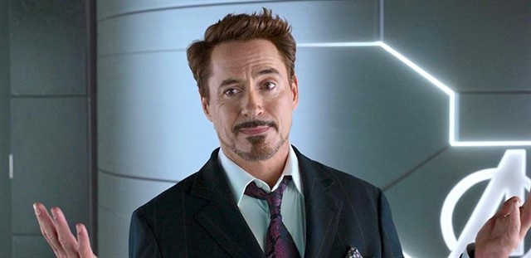
Ayush Patel
The one who knows Python
Local fascinated AI Guy
The Backend Guy
Loves To Open Computers

Slide 4
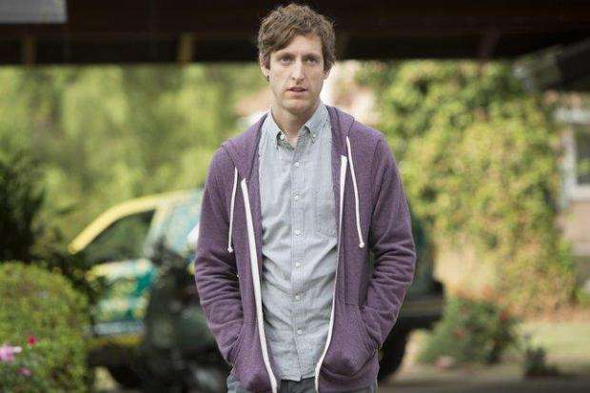
Hemang Bhogayata
The Software Guy
Local Game Dev and App Dev Expert
Loves Linux and GitHub More than his Life
Silicon Valley fan boy

